Slide 1

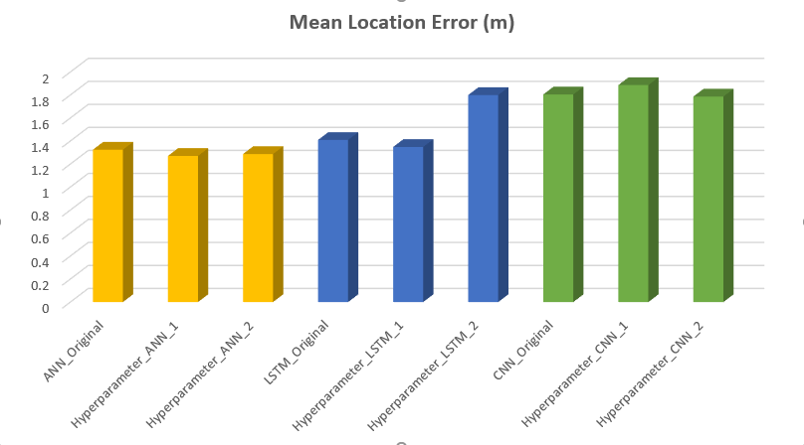
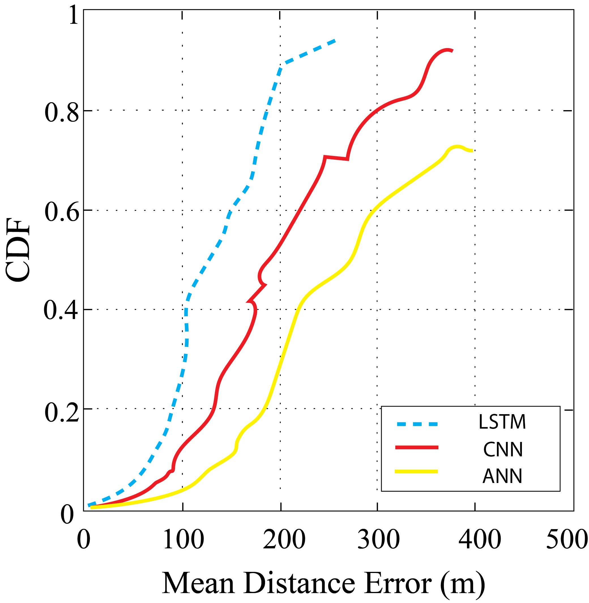
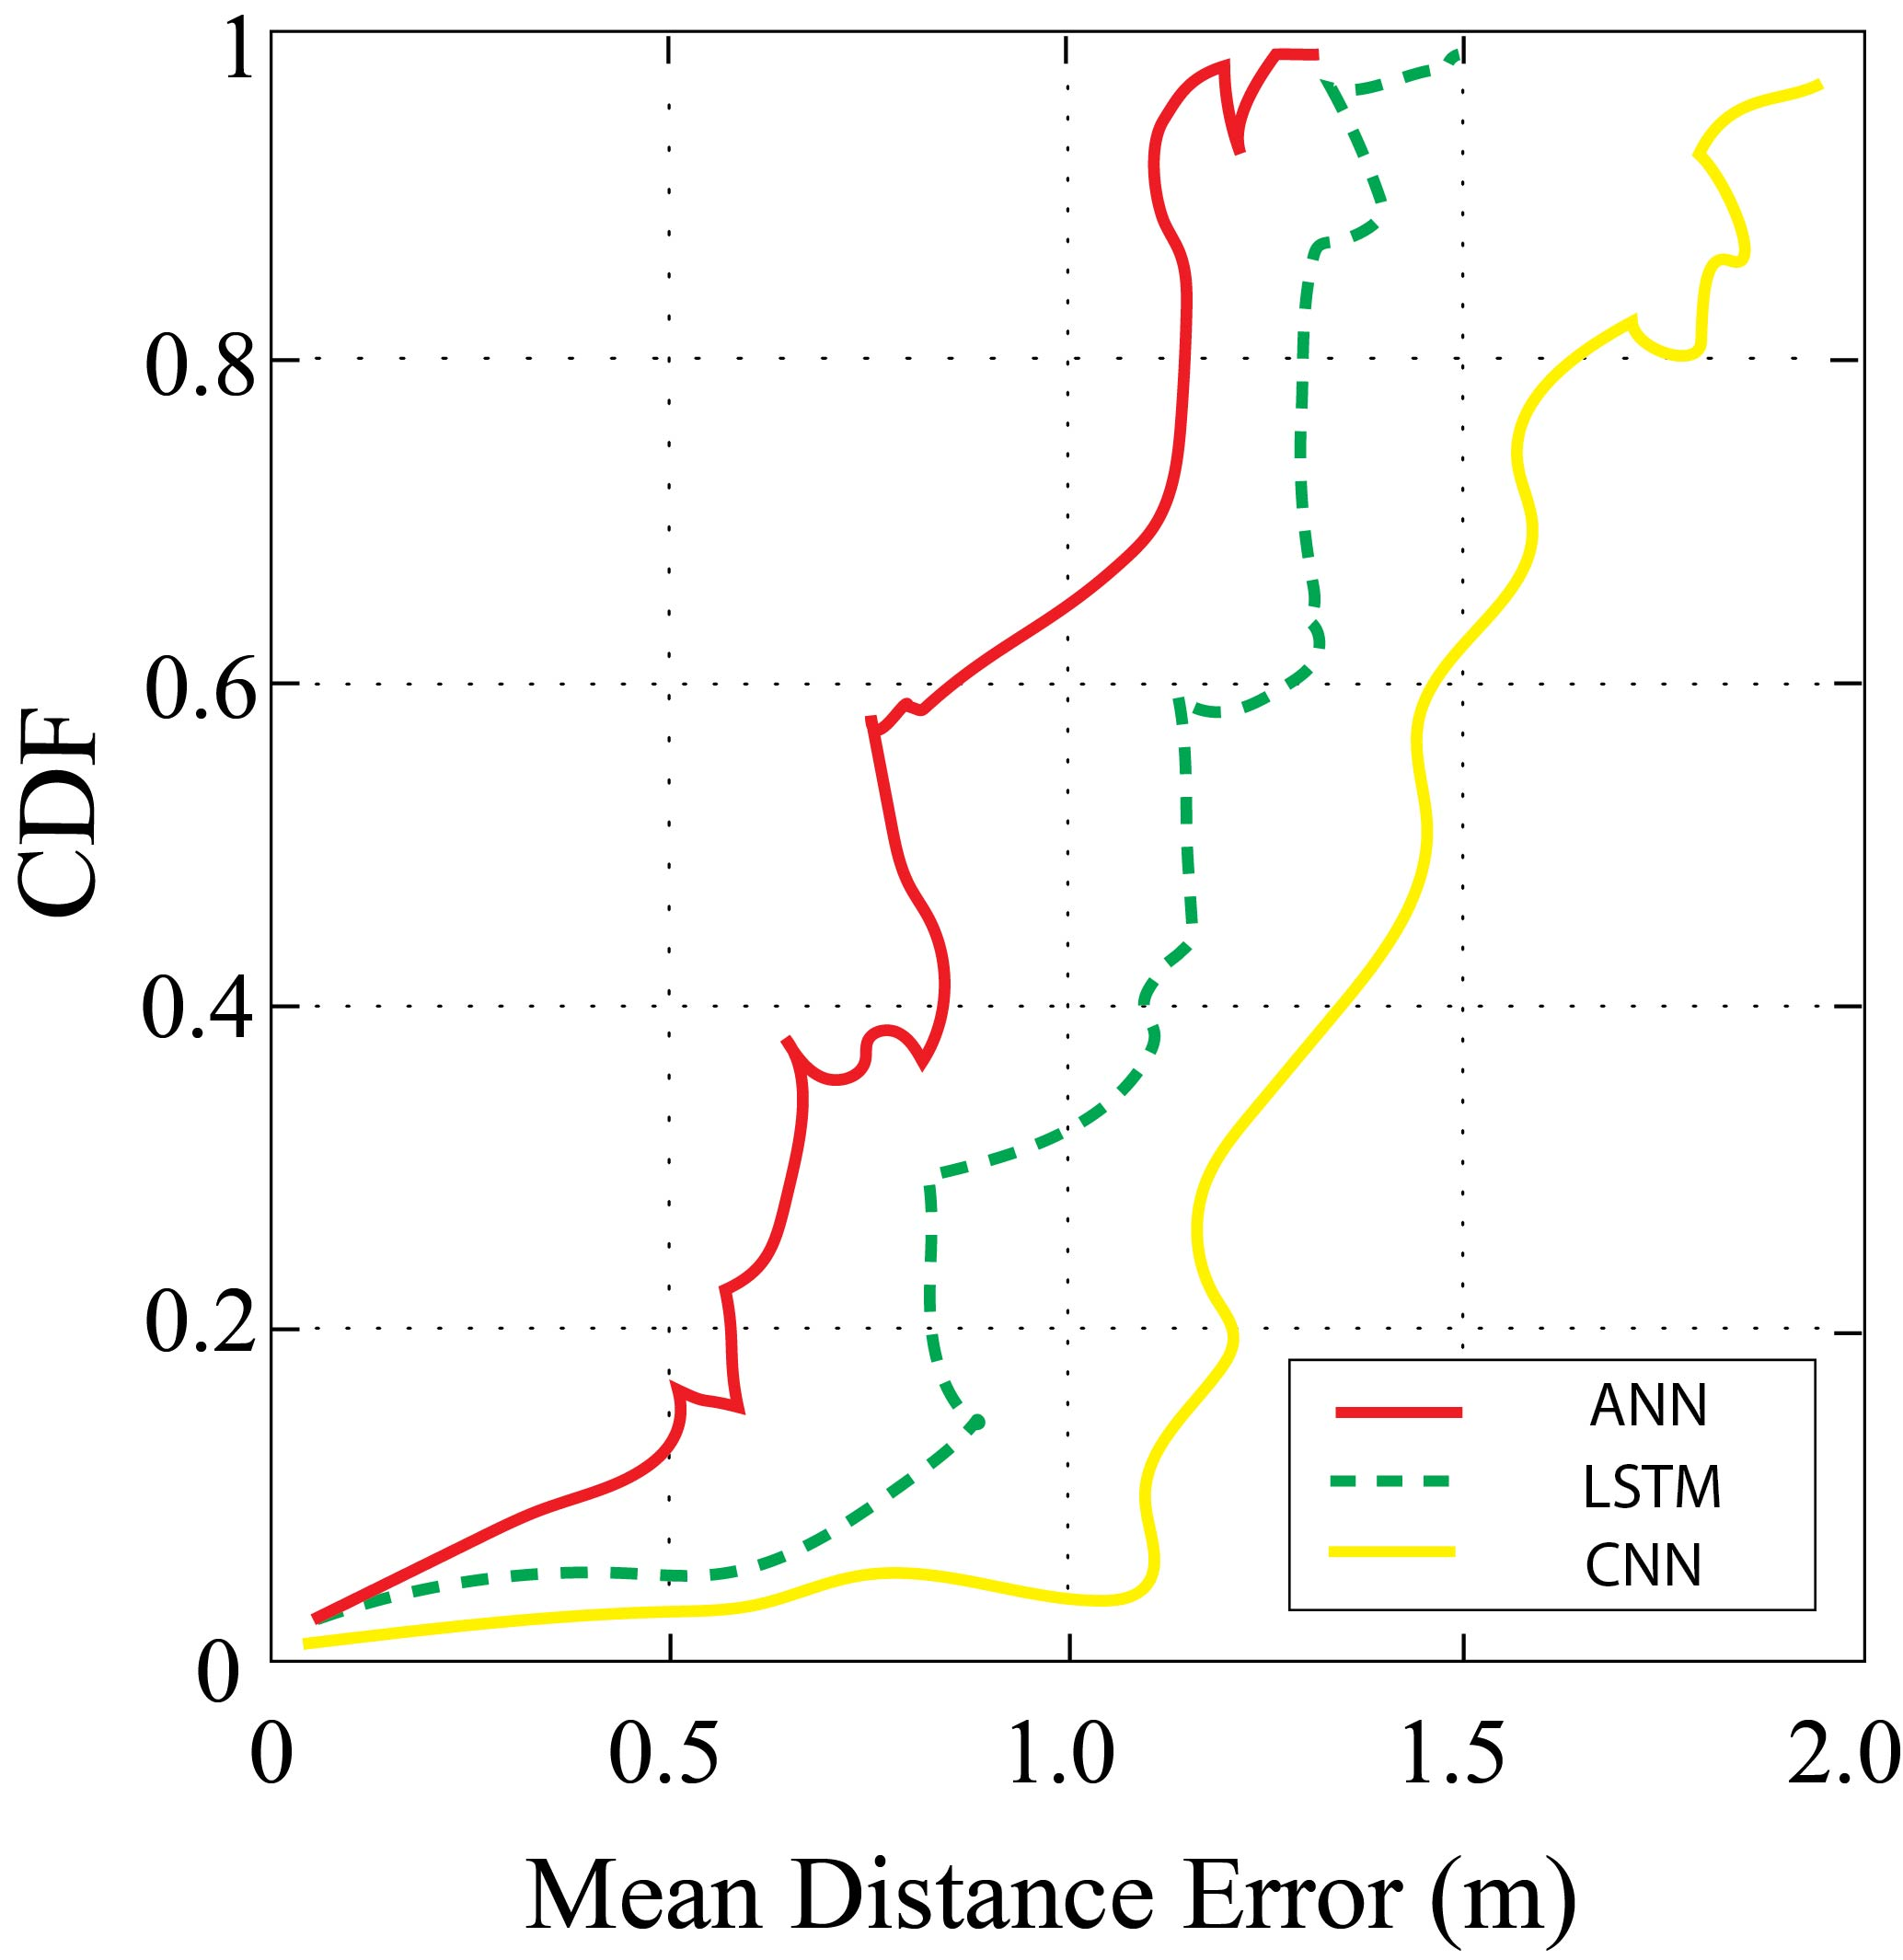
LoRa based Localization based Deep Learning Techniques
Jait Nitinkumar Purohit, Dr. Xuyu Wang (PhD)
Department of Computer Science, California State University, Sacramento
ABSTRACT
METHODOLOGY
RESULTS
CONCLUSIONS
Fingerprinting Localization, a common technique used in indoor positioning uses short-range radio frequency and addresses problems with multi-path. Although, there are challenges in fingerprinting approaches like spatial ambiguity, long distances, low-bandwidth, scalability, cost and size constraints. Additionally, Lora is more efficient in comparison to BLE and Wi-Fi considering challenges in GPS based applications. In offline phase of fingerprinting, 2D data at different locations have been collected in a university building, gathering RSSI values from the gateways at a fixed location. The online phase estimates the mean location error using Deep Learning models.
Additionally, we have implemented hyperparameter tuning to improve our results by changing optimizer parameters like learning-rate, batch-size, and tuning model parameters like number of hidden units, number of layers, activation functions and optimizers. Indoor experiments using DL techniques achieve 1.2-2.0 [m] of mean distance error. On the contrary, deep-learning techniques were implemented for publicly available outdoor data-source collected from several Lora-wan base-stations and nodes from Antwerp city, Belgium. Interpolation techniques using denoising auto-encoders have helped to interpolate outliers for this data. Our results have demonstrated that a mean distance error of 191.52 [m] from LSTM has out-performed results from the KNN algorithm. Impact of several LSTM design parameters have helped us to understand back-propagation algorithm in LSTM, to improve our results.
Figure 2: Deep Learning techniques used in fingerprinting localization
Outdoor Approach
The goal was to analyze the fingerprinting data and compare its algorithm’s result with that of our deep-learning algorithms publicly available lorawan dataset from Antwerp, Belgium.
Interpolation using Denoising Autoencoders
Autoencoders, a part of deep-learning neural networks are mainly used for selection and extraction. Denoising autoencoders solves our problem of outlier values in dataset by corrupting them on purpose and converting to null values. Theoretically, the percentage of null values in input nodes are about 50%, which depends on amount of data and input nodes we have. In our implementation, we have a function to shuffle data around and learn more about the data by attempting to reconstruct it. This process has helped to recognize the features within the noise and classify the input values. While training the neural network, it generates a model and measures the distance between the benchmark that has been set and the model through a loss function f(n). The loss function f(n) attempts to reduce the loss function by resampling the shuffled inputs and re-constructing the data-value, until it finds the actual value.
Training Deep Learning Neural network
Fingerprinting localization is improved to predict the accurate location and reduce generalization error using machine learning (ML) and Deep learning algorithms. Deep-learning algorithms like ANN, LSTM and CNN, were able to learn automatically about the features with multiple levels of non-linear operations. The hidden layers of neurons, backpropagation of weights, activation functions and neuron counts play an important role in deducing our hyper-tuning parameters. LSTM is our best model as it has the ability to remember and forget data based on gate weights and has major impact on localization accuracy.
Indoor Approach
The indoor environment is virtually divided into (X, Y) co-ordinate system. The base-stations are kept fixed in the RVR 3rd floor-lab while a DHT sensor sends data to them from different locations. Normalizing the dataset is necessary to change values of numeric columns to a common scale using min-max function.
Our best performing DL model was LSTM. It has special units in addition to standard units, which includes ‘memory cell’ to maintain information for longer periods. The gates of LSTM are used to control flow of information in the network. Our approach uses sequential LSTM which removes the assumption of speed noise, by collecting the data at different locations. It adjusts the internal weights through training stage. The weighted average filter is applied to overcome the signal instability issues during training and test RSSI calculations. The performance optimization using has been implemented with varying batch-sizes, activation functions, optimizers, and hidden layers. We have also compared our results with other deep-learning models like ANN and CNN.
The effectiveness of neural networks has been calculated depending upon mean location error for indoor and outdoor environments.
Figure 4: (A) Deep Learning Results for Outdoor Localization (B) Deep Learning Results for Indoor Localization
We proposed deep LSTM as our best model for indoor and outdoor localization. Outdoor localization results into 191.52 [m] of mean location error using 10 nearest neighbors to get a location estimate, while 1-2 [m] of mean location error for indoor localization using 2 fixed base-stations. We deduce that, using LSTM reduces problems related to vanishing gradient descent and helps to process very long sequences using tanh or relu as an activation function. The overfitting problem in indoor localization was removed using dropout layer set to 0.1.
Figure 4: (A) CDF of localization errors for outdoor environment (B) CDF of localization errors for indoor environment
Cumulative Distribution Function (CDF) of localization errors of DL models like LSTM, CNN and ANN are represented above. Outdoor results shows that 75% of location errors from LSTM are below 200 [m], while 40% for ANN and 50% for CNN are below 200 [m]. Indoor experiments shows that ANN and LSTM shows 59% of location errors are below 1.2 [m] in comparison to 38% from CNN. Thus, we can deduce that LSTM is performing better than other DL classifiers due to its capacity to deal with information handling using memory cells.
Hyperparameter tuning is implemented and has impacted the model performance, as different permutations and combinations of optimal parameters like learning-rate, batch-size, optimizers, activation functions and hidden layers.
Impact of hardware accelerator GPU vs TPU on model training:
The results we have gotten so far were ran on GPU hardware accelerator. We have compared it’s results with the deep-learning training done on google-colab’s TPU accelerator. Our experiments were running on a smaller convolutional neural network and we saw our results were skewed as custom network are not optimized for TPUs. Our dataset had approximately 120K records, divided into 90K training samples and 30K testing samples. We ran our experiments as described here in different scenarios below.
Scenario 1: LSTM model with 3 hidden layers and dropout = 0.1
Total epochs: 100
Activation function: sigmoid
Scenario 2: CNN model with 3 hidden layers and 2 dense layers
Total epochs: 100
Activation function: sigmoid
Iterations per epoch: 100
Therefore, we observed that training time in TPU is considerably more than the training time for GPU when the batch size is small. But, when the batch size increases, the performance of TPU is better than GPU.
This system has described the challenges in fingerprinting localization in an indoor and outdoor environment. Our results described in previous section about outdoor localization on Antwerp dataset improves the mean location error by using deep-learning techniques. These algorithms were implemented in order to improve previously defined results and to analyze short and long-term fluctuations in signal strengths over a large area in the city and understand capabilities of Lora as a technology in comparison to Bluetooth and Wi-Fi.
This paper also described a novel approach for fingerprinting localization using Lora based on deep-learning techniques. Our idea was to analyze indoor localization problems like spatial ambiguity, signal-strength fluctuations and non-linear relations in a typical indoor infrastructure layout and how Lora and deep-learning can help us mitigate them. Besides, the analysis and impact of different parameters of vanilla ANN, LSTM and CNN have been discussed in detail.
This paper also described a novel approach for fingerprinting localization using Lora based on deep-learning techniques. Our idea was to analyze indoor localization problems like spatial ambiguity, signal-strength fluctuations and non-linear relations in a typical indoor infrastructure layout and how Lora and deep-learning can help us mitigate them.
OBJECTIVE
REFERENCES
The aim of this project is design and implement a novel system to solve problems related to fingerprinting localization using using deep-neural network techniques and improve location accuracy in comparison to traditional approaches like pattern-matching and common machine-learning algorithms like KNN. The problems like non-linearity between sensor nodes and target base-stations, power-consumption and cost complications, typical infrastructure layouts, spatial ambiguity and RSSI signal instability in an indoor and outdoor environment are resolved using unique combination of Lora and deep-learning in tandem.
Figure 1: Fingerprinting localization in an indoor environment
The outdoor approach has 123,529 rows and 68 base-stations. The input features have lot of outliers and missing–values due to multi-lateration in offline phase. These outliers or missing values can cause localization problems as distance increases and aggravate the outdoor fingerprinting localization process. We have used denoising auto-encoders to corrupt these values purposely to null values. The denoising function that we have implemented shuffle the data by attempting to reconstruct it. The output features are latitude and longitude coordinates. The deep-learning models are trained for 70% training and 30% testing data-split. The indoor approach gathers the data from Lora end-node for multiple locations and send data to gateways kept at a fixed location.
The most challenging part of this project was to choose best model parameters to get the best accuracy and minimum mean location error using deep-learning. The indoor approach had less data and had problems related to overfitting, which were solved using dropout layers.
[1] Recurrent Neural Networks For Accurate RSSI Indoor Localization - Minh Tu Hoang, Brosnan Yuen, Xiaodai Dong, Tao Lu, Robert Westendorp, and Kishore Reddy
Available: https://arxiv.org/pdf/1903.11703.pdf
[2] Sigfox and LoRaWAN Datasets for Fingerprint Localization in Large Urban and Rural Areas - Michiel Aernouts, Rafael Berkvens, Koen Van Vlaenderen and Maarten Weyn
Available: https://www.mdpi.com/2306-5729/3/2/13
[3] DeepML: Deep LSTM for Indoor Localization with Smartphone Magnetic and Light Sensors - Xuyu Wang ; Zhitao Yu ; Shiwen Mao
Available: https://ieeexplore.ieee.org/abstract/document/8422562
[4] Deep Convolutional Neural Networks for Indoor Localization with CSI Images - Xuyu Wang ; Xiangyu Wang; Shiwen Mao
Available: https://ieeexplore.ieee.org/document/8468057
[5] Low-Power LoRa Signal-Based Outdoor Positioning Using Fingerprint Algorithm - Wongeun Choi, Yoon-Seop Chang, Yeonuk Jung and Junkeun Song [Online]
[6] Localization in Ultra Narrow Band IoT Networks: Design Guidelines and Trade-Offs - Hazem Sallouha , Sreeraj Rajendran [Online]
[7] LSTM by example using Tensorflow
Available: https://towardsdatascience.com/lstm-by-example-using-tensorflow-feb0c1968537
[8] Denoising Autoencoders Explained
Available: https://towardsdatascience.com/denoising-autoencoders-explained-dbb82467fc2
ACKNOWLEDGEMENTS
It gives me immense pleasure that I had an opportunity to work with Dr. Xuyu Wang for completing this project. His guidance and knowledge helped me to perform research on lora based localization using deep learning. I would like to thank professor Xiaoyan Sun for reviewing my master’s project report. I am grateful to CSU Sacramento and Computer science department for their continuous trust and faith in my success.
My parents and friends have helped me in multiple phases of my life and supported me to achieve master’s degree in computer science. I would like to say thanks to them for the faith and support.

